Slide 1
Gartley Patterns
Derek Miller, James Lagese, Madi Ricciuti, Nikitas Missos, Morgan Weinreber
Advised By: Dr. Moon Nguyen & Dr. Wakefield

Slide 2
Project Outline
Introduction
Forming a Basic Gartley Pattern
Types of Gartley Patterns​
How to Trade with Gartley Patterns
Examples Within the Stock Market​
Future Works
Conclusion

Slide 3
Introduction
Discovered by H.M. Gartley in the 1930’s​
The Gartley Pattern is a harmonic pattern series that uses Fibonacci ratios to identify buying and selling points​
They are one of the most common patterns used in trading and are often considered when making trades
They are used as indicators to where a stock has an extended pullback and is likely to reverse the trend (i.e. Buy low and Sell high)
Harmonic patterns construct geometric pattern structures using the Fibonacci sequence​s such as: bat pattern, crab pattern, and many others​
There are many rules and ratios that will be later discussed in forming a Gartley Pattern

Slide 4
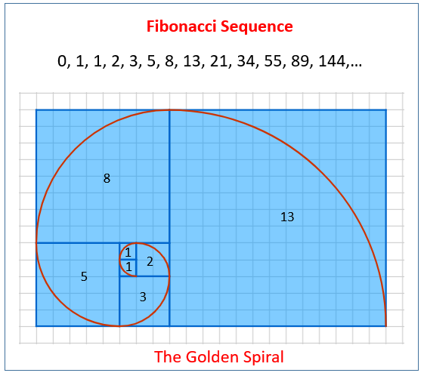
The Fibonacci Sequence and Golden Ratio
The Gartley Pattern is based on the Fibonacci Sequence: 0, 1, 1, 2, 3, 5, 8, 13, 21, etc.
When you divide a number in the sequence by the previous number, the result gets closer to the golden ratio 1.618 as the sequences goes on
The golden ratio shows up in the stock market. The Fibonacci Retracement of 61.8% is commonly used as a trading level in stock market charts including the Gartley Pattern.

Slide 5
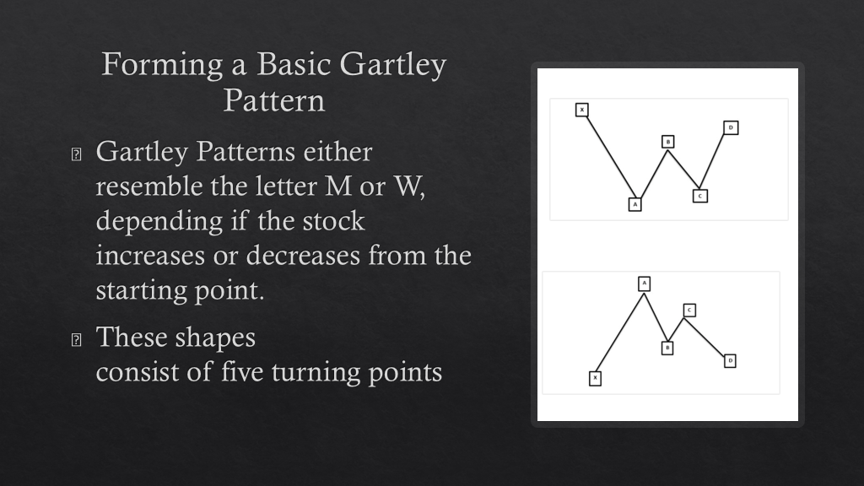

Slide 6
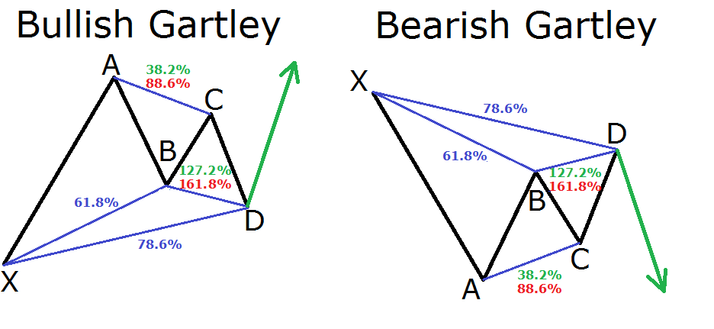
Types of Gartley Patterns

Slide 7
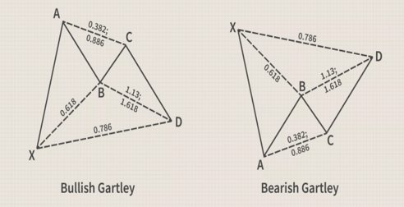
Types of Gartley Patterns
Pattern Type​ | B of XA​ | BC of A | D of AB​ | D of XA​
Gartley​ | 0.618​ | 0.382 - 0.886​ | 1.272 - 1.618​ | 0.786​
Bat​ | 0.382 - 0.5​ | 0.382 - 0.886​ | 1.618 - 2.618​ | 0.886​
Butterfly​ | 0.786​ | 0.382 - 0.886​ | 1.618 - 2.214​ | 1.272​
Crab​ | 0.382 - 0.618​ | 0.382 - 0.886​ | 2.24 - ​3.618​ | 1.618​
Cypher​ | 0.382 - 0.618​ | 1.272 - 1.414​ | Not Required​ | 0.786​

Slide 8
Basic Gartley Trading Rules
Pattern is harmonic
Swings correspond to values derived from Fibonacci numbers
Once a pattern is established the required numbers must follow that of the pattern
XA - User decided
AB – A retracement of XA corresponding to a pattern type
BC – A reverse retracement of AB sticking with the same pattern
CD – A reverse extension of BC
AD – A reverse retracement of XA

Slide 9
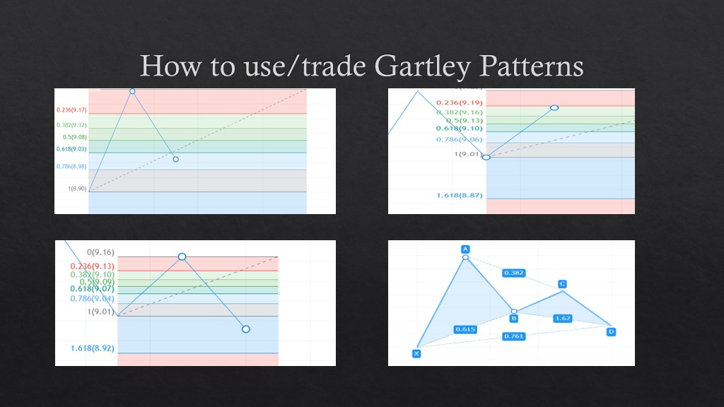

Slide 10
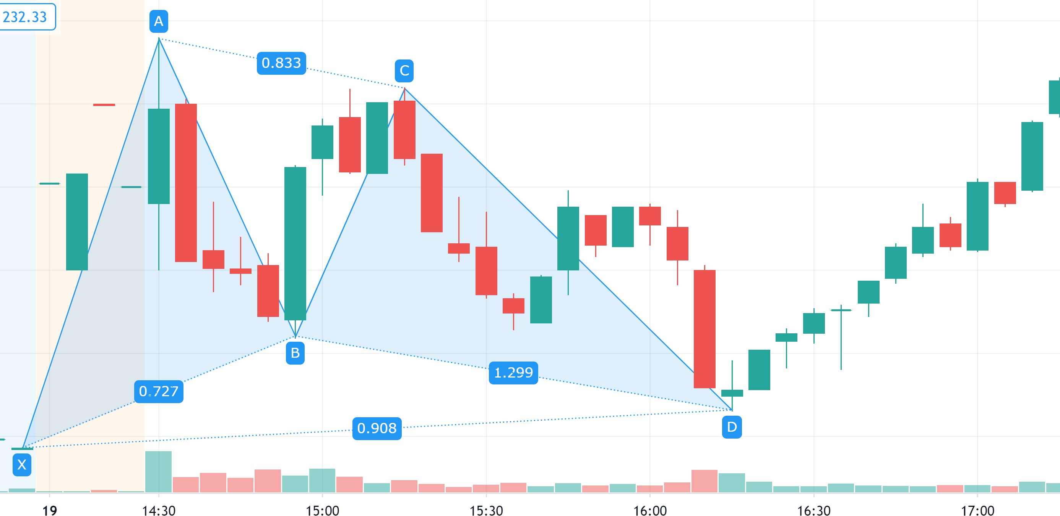
Real example of Trading the Gartley Pattern (MSFT)

Slide 11

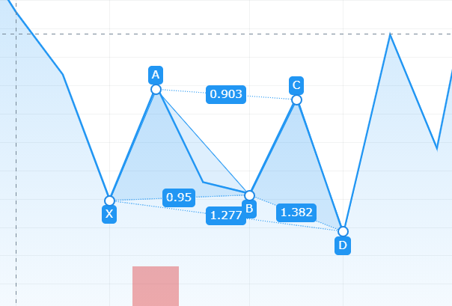

Bullish Butterfly Example on GME

Slide 12
Future Works
In the future we would like to develop machine learning to trade using the Gartley Pattern.
Having a system would allow automatic buying and selling points due to different Gartley Shapes
Continue to use Gartley patterns as indicators but incorporate other techniques to maximize accuracy and profits
Simulate buying and selling using the machine learning on real time stocks

Slide 13
Conclusion
Gartley Patterns can be useful to use for predicting when to buy/sell
Exact numbers are not needed, but the closer the better
When buying in with a bullish pattern use the initial point as a stop-loss point to cut back on losses
The process is difficult to automate so it can be tedious and require patience
Due to the volatility of the stock market this is not a 100% guarantee, but it can help determine buy/sell points

Slide 14
References
BabyPips.com. (2017, July 13). Trading The Gartley Pattern. BabyPips. https://www.babypips.com/learn/forex/the-gartley-and-the-animals
Duddella, S. (n.d.). Harmonic Patterns. StockCharts. Retrieved January 6, 2021, from https://school.stockcharts.com/doku.php?id=trading_strategies:harmonic_patterns%E2%80%8B
Kuepper, J. (2020, January 16). Gartley Pattern Definition. Investopedia. https://www.investopedia.com/terms/g/gartley.asp
All Gartley Patterns in the Stock Market were found and graphed by us using Tradingview's Gartley tool

